Slide 1
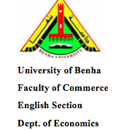
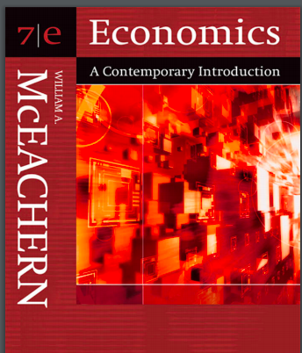
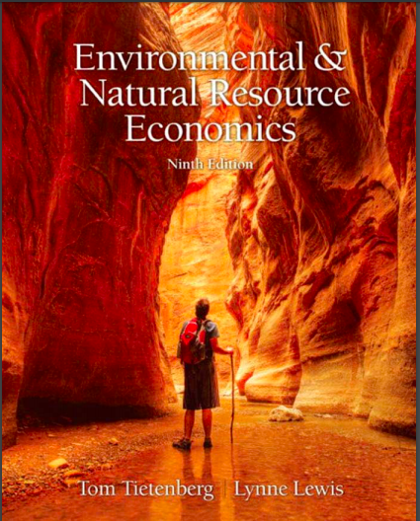
Resources and Environmental Economics
_{First Term 2019/2020}
Lecture 6
PowerPoint Slides
prepared by
Dr. Walaa W. Diab
FCOM-BU

Slide 2
Resources and Environmental Economics
_{First Term 2019/2020}
_{COURSE SYLLABUS}
PowerPoint Slides
prepared by
Dr. Walaa W. Diab
FCOM-BU
1- Instructor Contact Info.
Name: Dr. Walaa Wageh Diab
Office Hours: from 8:30 am to 9 am each Wednesday
Online Office Hours: Each Friday at 1pm to 3 pm
Class meets Wednesday
Email: Walaa.dyab@fcom.bu.edu.eg
Course website:
Lecture slides and exercises accessible through My official page:
http://bu.edu.eg/staff/walaadyab4

Slide 3
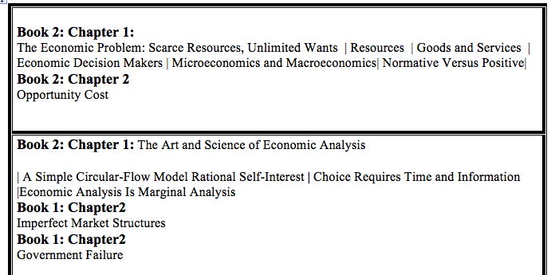
Resources and Environmental Economics
_{First Term 2019/2020}
_{COURSE SYLLABUS}

Slide 4
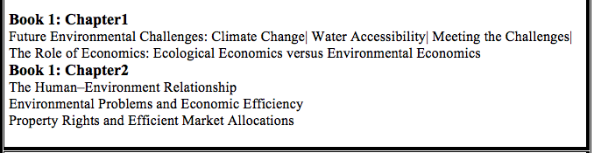
Resources and Environmental Economics
_{First Term 2019/2020}
_{COURSE SYLLABUS}

Slide 5
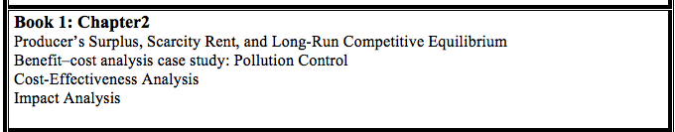
Resources and Environmental Economics
_{First Term 2019/2020}
_{COURSE SYLLABUS}

Slide 6
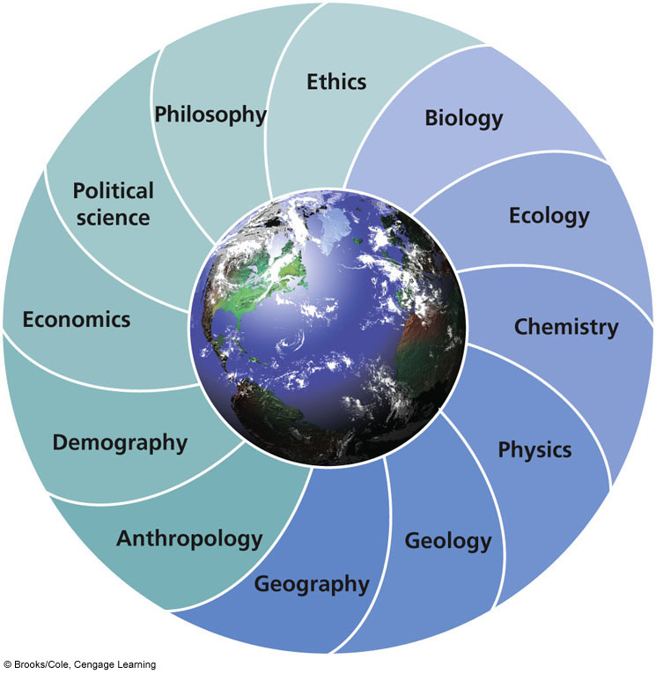
Environmental Science: Interdisciplinary Study
Notes:
Example: Dust Bowl, Great Depression, math, chemistry

Slide 7

Our Goals
Learn how nature works
Learn how the environment affects us
Learn how we affect the environment
Learn how to deal with environmental problems and live more sustainably

Slide 8
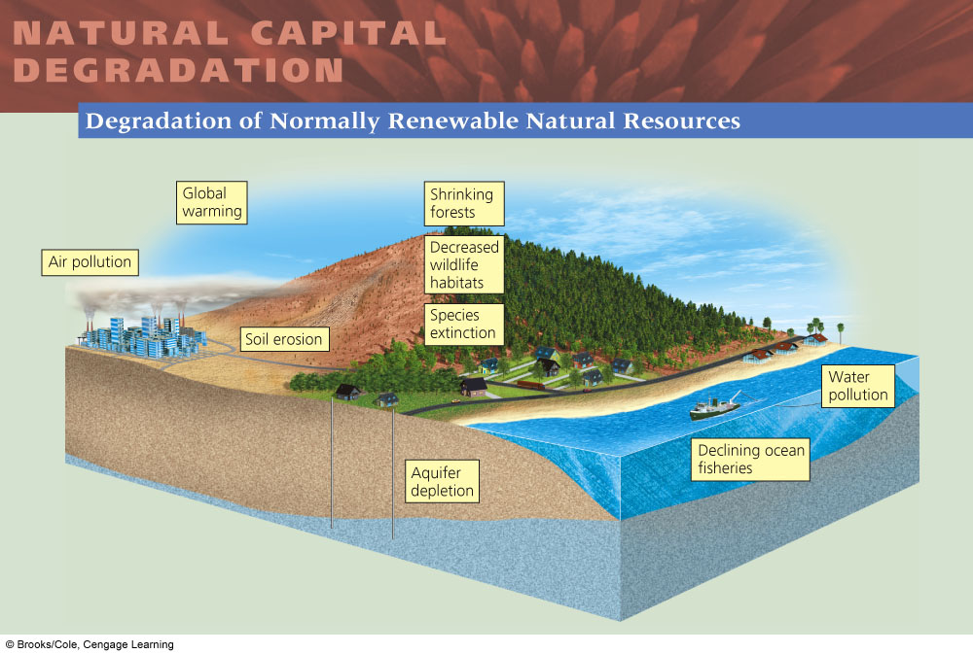
Consumption and Conservation
Resource – anything obtained from the environment to meet our needs and wants
  Renewable
    Air, water, trees, etc.
  Nonrenewable
    Coal, oil, etc.
Notes:
8

Slide 9

Money doesn’t grow on trees
Natural capital: keeps us and other forms of life alive and supports our economies
  Natural resources – materials; air, water, soil, etc.
  Natural services – functions; nutrient cycling

Slide 10
The environment also provides services directly to consumers. The air we breathe, the nourishment we receive from food and drink, and the protection we derive from shelter and clothing are all benefits we receive, either directly or indirectly, from the environment.

Slide 11
In this chapter, we develop the general conceptual framework used in economics to approach environmental problems.
Begin by examining the relationship between human actions, as manifested through the economic system, and the environmental consequences of those actions.

Slide 12
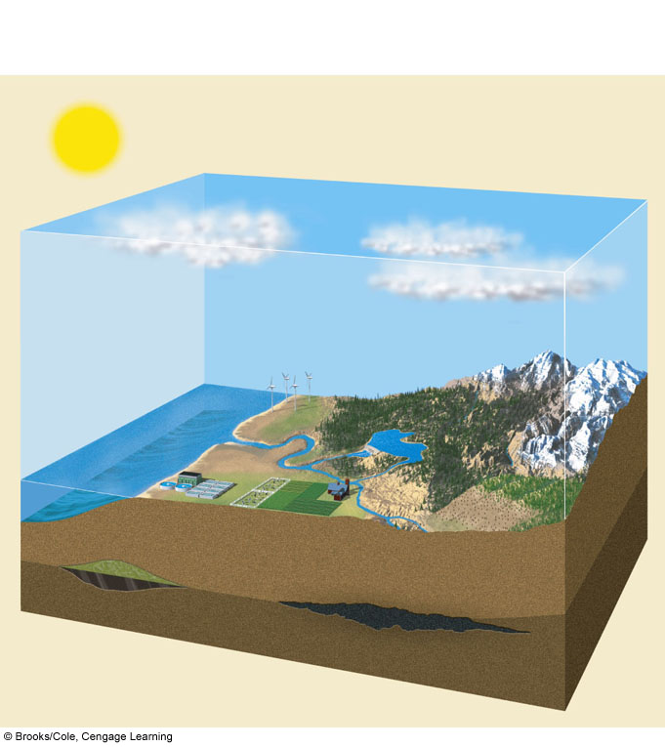

NATURAL CAPITAL
Natural Capital = Natural Resources + Natural Services
Solar
capital
Air
Air purification
Renewable
energy
(sun, wind,
water flows)
Climate control
UV protection
(ozone layer)
Life
(biodiversity)
Water
Water purification
Population
control
Waste treatment
Pest
control
Solar Capital…can we survive without it???
Nonrenewable
minerals
iron, sand)
Land
Soil
Soil renewal
Food production
Natural gas
Nutrient
recycling
Oil
Nonrenewable
energy
(fossil fuels)
Coal seam
Natural resources
Natural services
Fig. 1-3, p. 8
Notes:
Key natural resources (blue) and natural services (orange) that support and sustain the earth’s life and economies

Slide 13
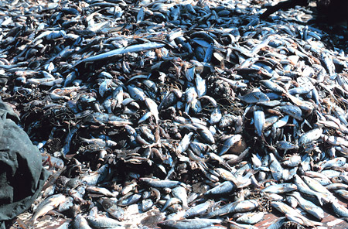
Human Degradation!
Human activities degrade natural capital
Using normally renewable resources faster than nature can renew them
  Forestry
  Fishing
Notes:
Globally, humans are degrading 62% of natural services

Slide 14
Different Views about Environmental Problems and Their Solutions
Environmental Worldview including environmental ethics
  Planetary management worldview
  Stewardship worldview
  Environmental wisdom worldview
Notes:
Planet – we are separate from nature, nature exists mainly to meet our needs and meet our wants
Stewardship – we should manage the world for our benefit, but we have an ethical responsibility to care for it and be stewards of the earth
Wisdom – we are a part of, and totally dependent on nature, and it exists for all living things, not just humans
14

Slide 15
We derive most of our energy from the sun. We have also sent spaceships well beyond the boundaries of our atmosphere. Nonetheless, for material inputs and outputs (not including energy), this system can be treated as a closed system because the amount of exports (such as abandoned space vehicles) and imports (e.g., moon rocks) are negligible.

Slide 16
We can then establish criteria for judging the desirability of the outcomes of this relationship. These criteria provide a basis for identifying the nature and severity of environmental problems, and a foundation for designing effective policies to deal with them.
If the environment is defined broadly enough, the relationship between the environment and the economic system can be considered a closed system.

Slide 17
A closed system is one in which no inputs (energy or matter) are received from outside the system and no outputs are transferred outside the system.
An open system, by contrast, is one in which the system imports or exports matter or energy.

Slide 18
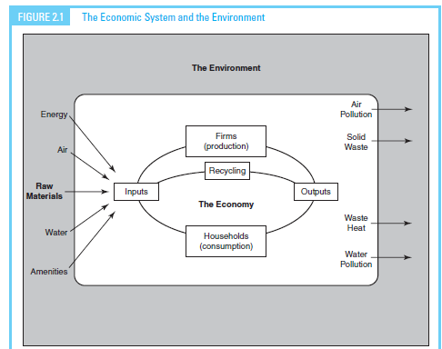
If we restrict our conception of the relationship in Figure 2.1 to our planet and the atmosphere around it, then clearly we do not have a closed system.

Slide 19
Whether the system remains closed depends on the degree to which space exploration opens up the rest of our solar system as a source of raw materials.

Slide 20
The treatment of our planet as a closed system has an important implication that is summed up in the first law of thermodynamics— energy and matter can neither be created nor destroyed.

Slide 21
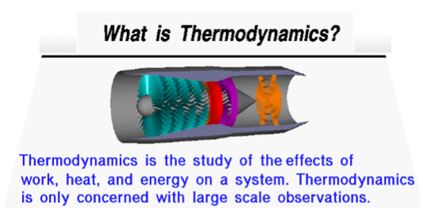

Slide 22
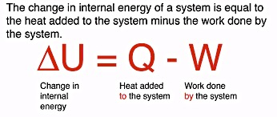
the first law of thermodynamics—
energy and matter can neither be created nor destroyed. The law implies that the mass of materials flowing into the economic system from the environment has either to accumulate in the economic system or return to the environment as waste.

Slide 23

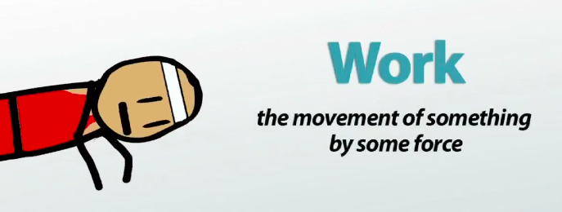
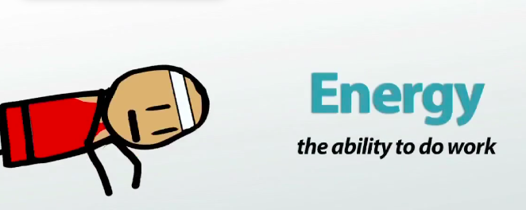
the first law of thermodynamics—

Slide 24
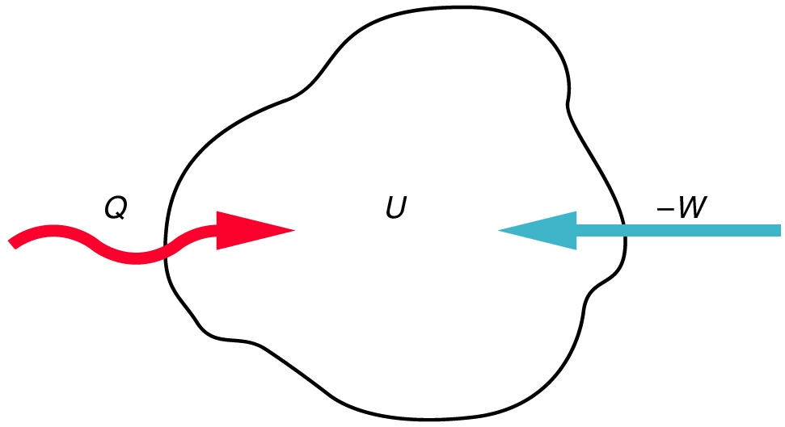
The internal energy U of a system is increased by
the transfer of either heat or work into the system.

Slide 25
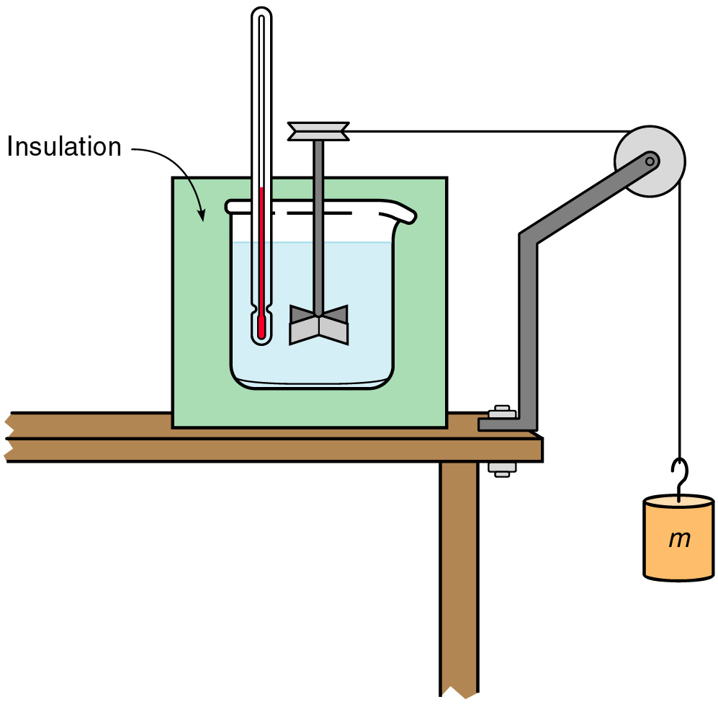
A falling mass turns a paddle in an insulated beaker of
water in this schematic representation of Joule’s
apparatus for measuring the temperature increase
produced by doing mechanical work on a system.

Slide 26
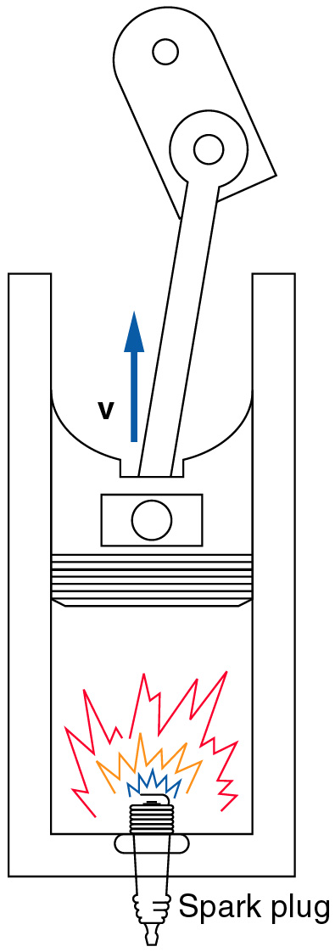
Heat released by burning gasoline in the cylinder of an automobile engine causes the piston to
move, converting some of the heat to work.

Slide 27
What is INTERNAL ENERGY?
The internal energy of the system is the sum of the kinetic and potential energies of the atoms and molecules making up the system.

Slide 28
The First Law of Thermodynamics:
The increase in the internal energy of a system is equal to the amount of heat added to the system, plus the amount of work done on the system.
The increase in the internal energy of a system is equal to the amount of heat added to the system, minus the amount of work done by the system.
ΔU = Q - W
Q=heat add to system
W = work done by system

Slide 29
The treatment of our planet as a closed system has an important implication that is summed up in the first law of thermodynamics— energy and matter can neither be created nor destroyed.
The law implies that the mass of materials flowing into the economic system from the environment has either to accumulate in the economic system or return to the environment as waste. When accumulation stops, the mass of materials flowing into the economic system is equal in magnitude to the mass of waste flowing into the environment

Slide 30
Excessive wastes can depreciate the asset; when they exceed the absorptive capacity of nature, wastes reduce the services that the asset provides.
i.e.: air pollution can cause respiratory problems; polluted drinking water can cause cancer; smog block out beautiful views; climate change can lead to flooding of coastal areas..

Slide 31
The relationship of people to the environment is also conditioned by another physical law, the second law of thermodynamics.

Slide 32
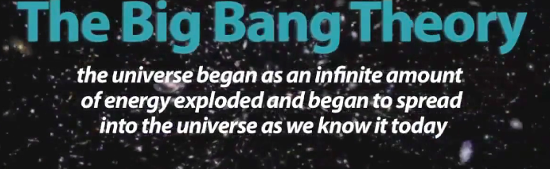
the first law of thermodynamics—

Slide 33
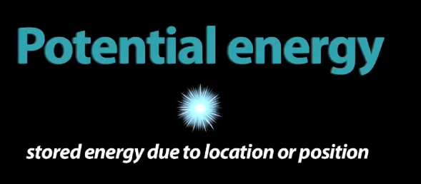
the first law of thermodynamics—

Slide 34
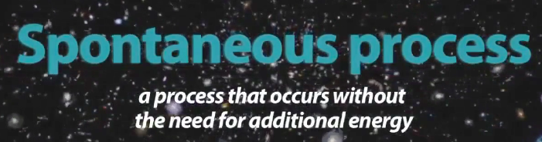
the first law of thermodynamics—

Slide 35
The Second Law of Thermodynamics
No engine, working in a continuous cycle, can take heat from a reservoir at a single temperature and convert that heat completely into work.
This shows that it is not possible too have an efficiency of 100%. You always lose some energy into heating the environment.

Slide 36
A restatement of the Second Law which turns out to be equivalent:
Heat will not flow from a colder body to a hotter body unless some other process (which does work) is also involved.
Another restatement to be discussed next time:
The entropy of an isolated system can only increase or remain constant. Its entropy cannot decrease.

Slide 37
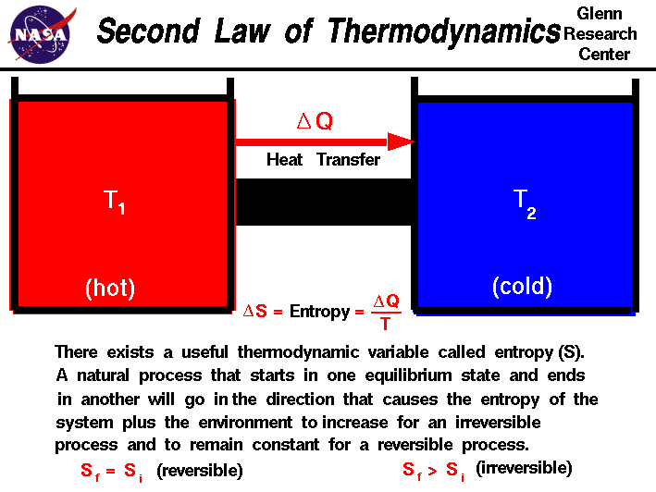
the second law of thermodynamics
Known popularly as the entropy law, this law states that “entropy increases.”

Slide 38
The relationship of people to the environment is also conditioned by another physical law, the second law of thermodynamics. “entropy increases.”
Entropy is the amount of energy unavailable for work. Applied to energy processes, this law implies that no conversion from one form of energy to another is completely efficient and that the consumption of energy is an irreversible process.

Slide 39
Some energy is always lost during conversion, and the rest, once used, is no longer available for further work.
In the absence of new energy inputs, any closed system must eventually use up its available energy. Since energy is necessary for life, life ceases when useful energy flows cease.

Slide 40
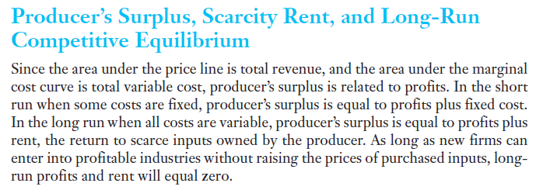
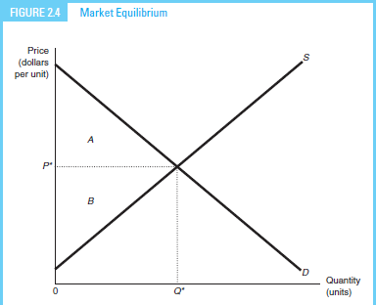

Slide 41
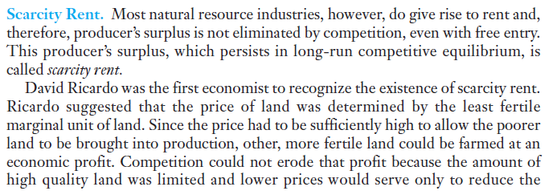


Slide 42
Exclusivity is one of the chief characteristics of an efficient property rights structure. This characteristic is frequently violated in practice. One broad class of violations occurs when an agent making a decision does not bear all of the consequences of his or her action.

Slide 43
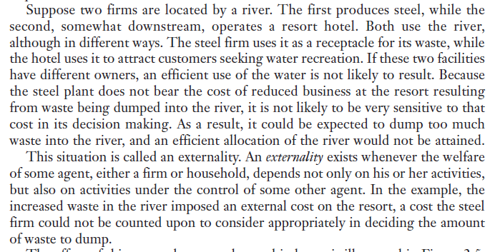


Slide 44
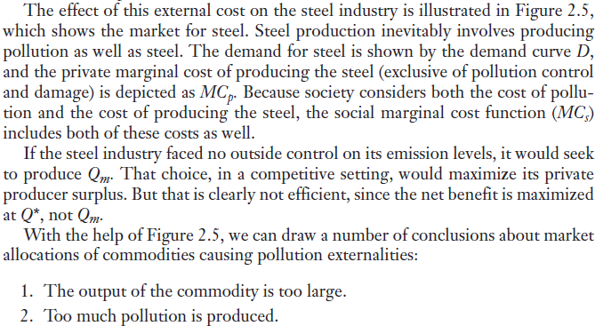
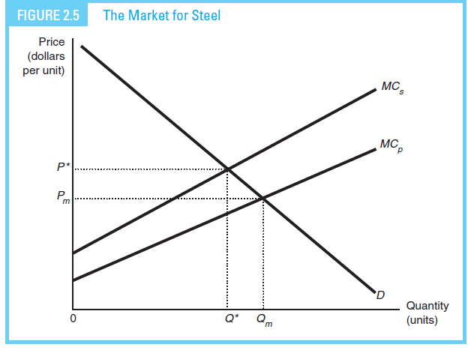

Slide 45
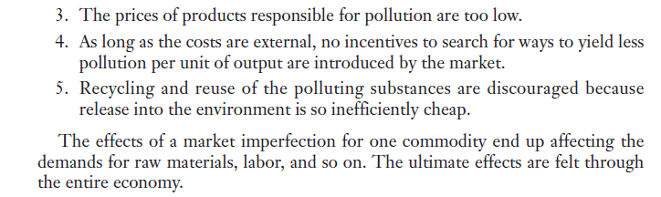

Slide 46
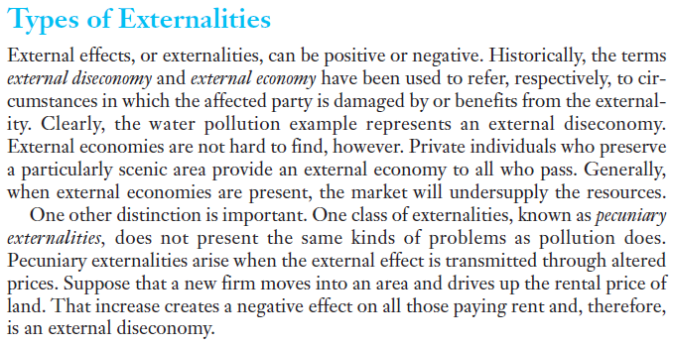

Slide 47
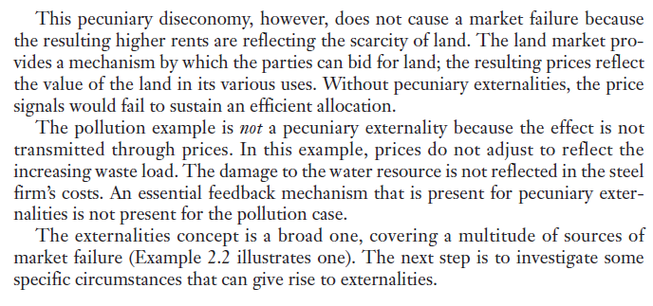

Slide 48
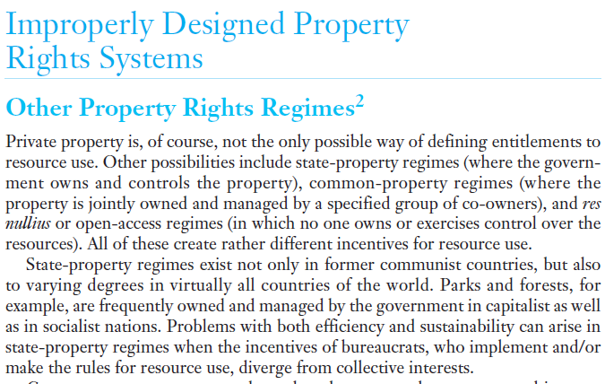

Slide 49
Property Rights
Bundle of entitlements defining the owner’s rights, privileges, and limitations for use of a resource (Tietenberg)
Rules that specify both the proper relationships among people with respect to the use of things and the penalties for violating those proper relationships (Randall)

Slide 50
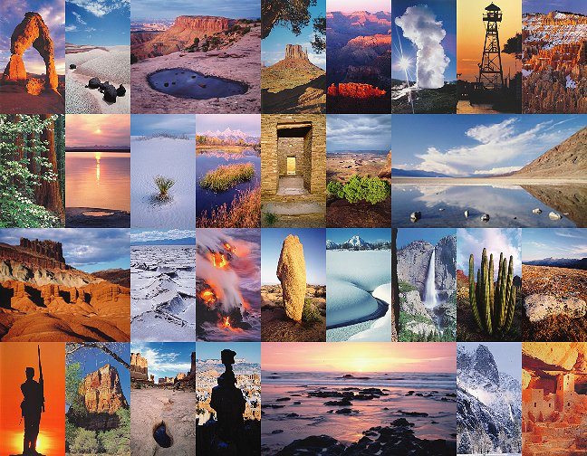
Overexploiting Shared Renewable Resources: Tragedy of the Commons
Three types of property or resource rights
  Private property
  Common property
  Open access renewable resources
Notes:
Open access – land is owned by no one and available for use by anyone at little or no charge
1/3 of US land is common property
50

Slide 51
Non-attenuated property rights are:
Completely specified
Exclusive
Transferable
Enforceable and enforced

Slide 52
How is property held?
Who has rights of use?
Private property
Common property
Public property
Open access (res nullius)

Slide 53

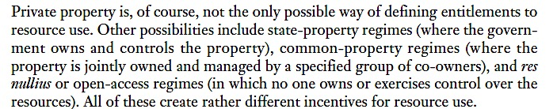

Slide 54
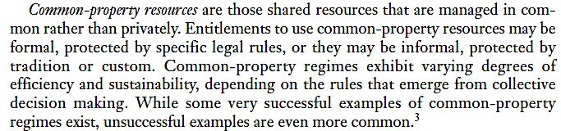

Slide 55
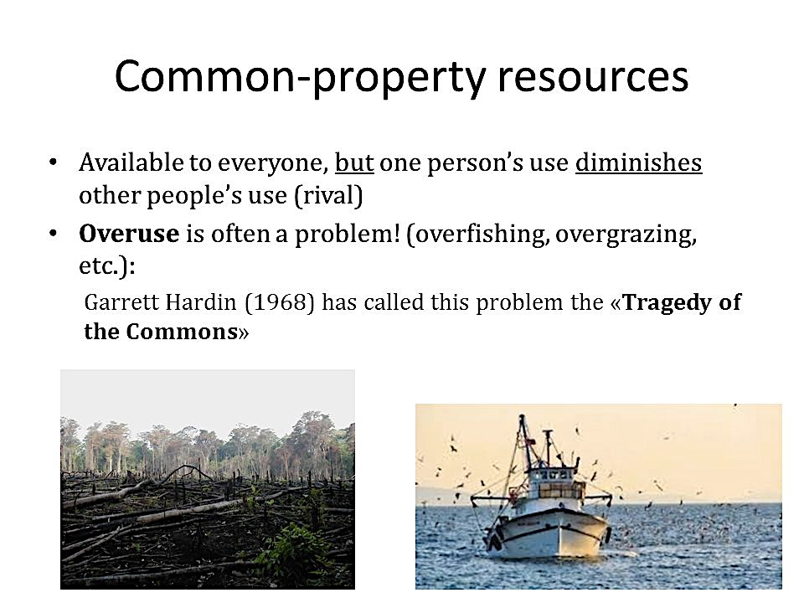

Slide 56
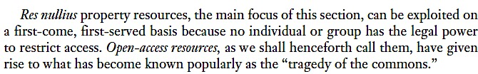

Slide 57
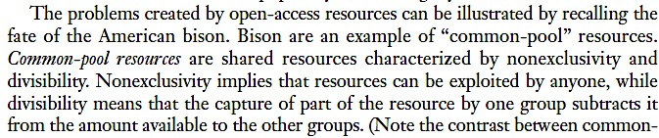

Slide 58
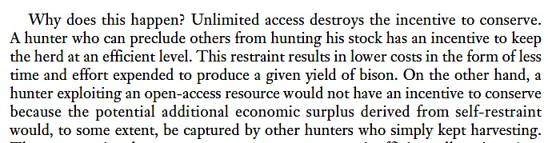

Slide 59
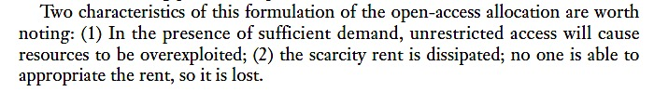

Slide 60
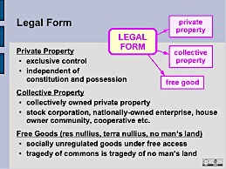

Slide 61
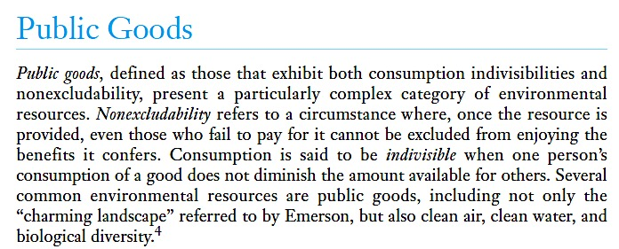

Slide 62
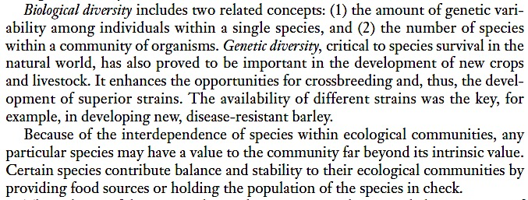

Slide 63
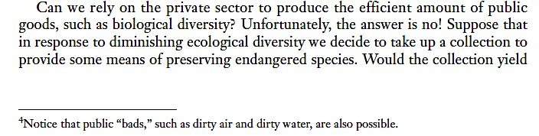

Slide 64
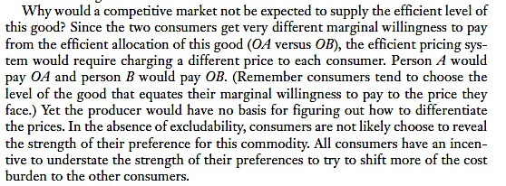

Slide 65
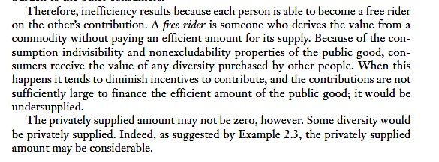

Slide 66
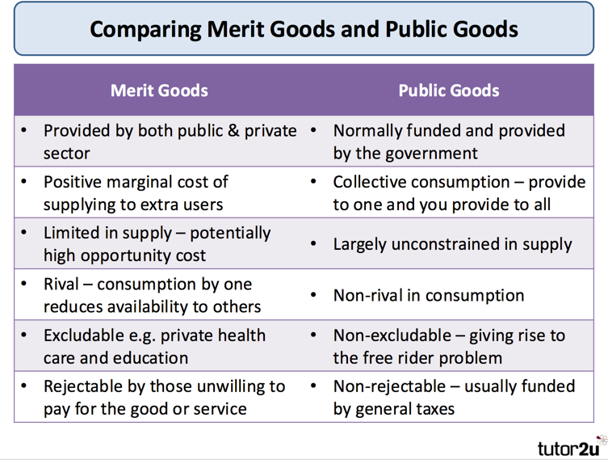

Slide 67
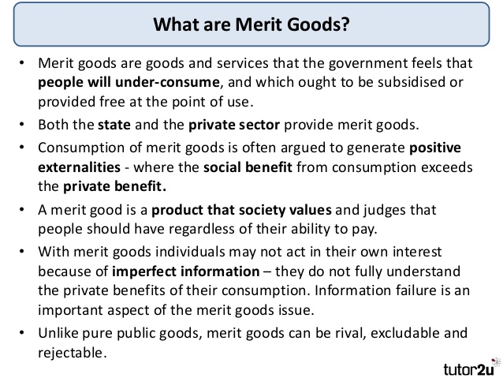

Slide 68
Merit goods are goods which are deemed to be socially desirable, and which are likely to be under-produced and under-consumed through the market mechanism. This is the case with healthcare and it is therefore usually categorised as a merit good.

Slide 69
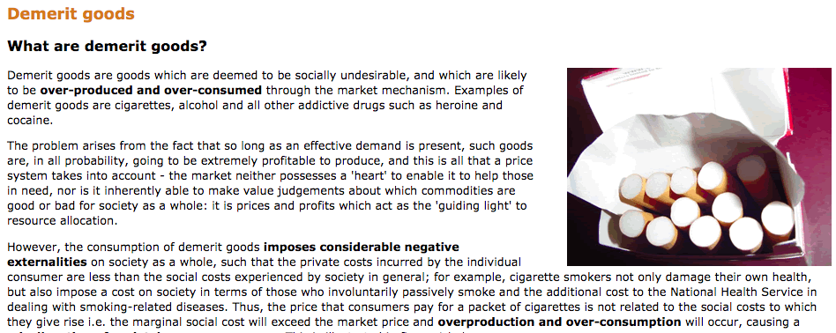
http://www.sanandres.esc.edu.ar/secondary/economics%20packs/microeconomics_sl/page_118.htm

Slide 70
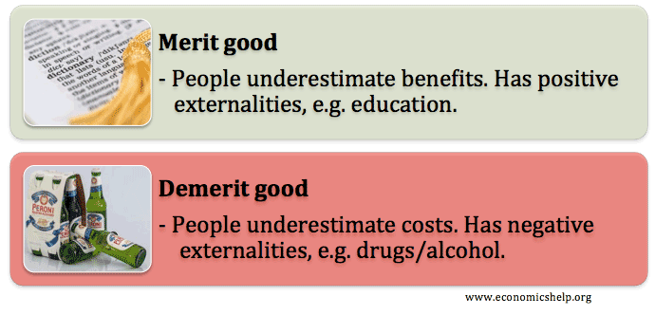

Slide 71


Slide 72




